Slide 1
Normalization
Basic (1st, 2nd, 3rd Forms) -
Referential Integrity: PK-FK (between tables)
Attribute Dependencies: Functional, Transitive (within the table itself)
Advanced (BCNF, 4th, 5th , 6th Forms) -
Superkey, Multivalued, Join, DKNK

Slide 2
Data Normalization
A formal process for grouping attributes by table.
A tool to validate and improve logical designs so that they satisfy certain constraints to avoid unnecessary redundancy of data.
It can be used to validate the structures of any relational tables, even those created through ERD conversions (to double-check the design).
The process of decomposing a table with anomalies into two or more, smaller, well-structured tables.

Slide 3
Normalization
ERD “Unnormalized”
remove
multivalued
attributes
First
Normal Form
remove
partial functional
dependencies
Basic design is to get to Third Normal Form (3NF).
Second
Normal Form
remove
transitive
dependencies
Third
Normal Form
Boyce-Codd Normal Form
Fourth
Normal Form
Advanced Database
Fifth
Normal Form

Slide 4
Dependencies (within the table itself)
Functional (2nd NF)
One attribute (PK) determines all the other (non-key) attributes.
Partial Functional - a non-key attribute depends on part of candidate key or compound key (CPK).
Transitive (3rd NF)
A non-key attribute determines another non-key attribute.
Solution is to break out new table to pull out attributes that are creating the dependencies.

Slide 5
Functional Dependencies: (double arrow problem) Partial Functional (2NF - key attribute) Transitive (3NF - non-key attribute)
How to handle them:
Follow the direction of the arrows
The attribute at the start of the arrow becomes the PK in the new table.
It leaves behind itself as a FK pointing to the PK in the new table.

Slide 6
Partial Functional Dependencies PK with “double arrow problem”
1NF
PartNo
Description
VendorName
City
UnitCost

Slide 7
Partial Functional Dependencies: “Follow the direction of the arrows”
1NF
PartNo
Description
VendorName
City
UnitCost

Slide 8
Partial Functional Dependencies: “Follow the direction of the arrows”
1NF
PartNo
Description
VendorName
City
UnitCost

Slide 9
When in doubt, break it out (new table that is)
synonym
Catalog
PartNo
VendorName
UnitCost
Vendor
VendorName
City

Slide 10
Partial Functional Dependencies: “Follow the direction of the arrows”
1NF
PartNo
Description
VendorName
City
UnitCost

Slide 11
When in doubt, break it out (new table that is)
Part
PartNo
Description
synonym
Catalog
PartNo
VendorName
UnitCost

Slide 12
Partial Functional Dependencies: “The remaining attributes left behind”
1NF
PartNo
Description
VendorName
City
UnitCost

Slide 13
When in doubt, break it out (new table that is)
Part
PartNo
Description
synonym
Catalog
PartNo
VendorName
UnitCost
Vendor
VendorName
City

Slide 14
Transitive Dependency (non-key attribute) “double arrow problem”
EmpID
CourseTitle
Date
Completed
2NF
EmpID
EmpName
DeptName
DeptPhone
Space saver, not a functional reason

Slide 15
When in doubt, break it out (new table that is)
EmpID
CourseTitle
Date
Completed
3NF
EmpID
EmpName
DeptName
DeptName
DeptPhone

Slide 16
Review: “The Key, The Whole Key, and Nothing but the Key”
The Key (1NF): All attributes are single, atomic values.
The Whole Key (2NF): all non-key attributes depend on the entire PK.
Think query – “show me attributes associated with ItemID number 101.”
And Nothing but the Key (3NF): no non-key value depends on another non-key value.

Slide 17
Advanced Design Using Higher Normal Forms to Improve Performance/Optimizing Queries

Slide 18
“The Key, The Whole Key, and Nothing but the Key…. (1st, 2nd , 3rd)
and
…the super key, the multi-valued key, the join lossless key, and domain key… (BCNF, 4th, 5th, 6th)

Slide 19
So help me Codd! (Boyce-Codd, that is)
BCNF (3.5): Super Key
Are there an overlapping candidate keys?
4NF: Multi-valued dependency (also called a “trivial” transitive dependency)
Does the Primary key determine non-key attributes individually, that are independent of each other?
5NF: Join Dependency
Can we break tables into smaller component tables and be able to join them back?
Think Vertical Partition (scan time, seek time)
Can I make my queries (joins) run faster if I break these tables into smaller tables?
6NF: DKNF (domain key normal form)
Can the table be reduced to the absolute minimum number of columns?
Think look up tables, reduction to two column tables if possible.
Example: <city, state, zip>

Slide 20
Boyce-Codd (3.5NF): Overlapping Candidate Keys
“Super Key” Test:
Is every other attribute functionally dependent only on the entire primary key (“the whole key”), whether single or composite?
A Super Key is the primary key, by itself, or comprised of more than one candidate key, that ALL OTHER columns are functionally dependent upon.
Super Key is used only in BCNF discussion. 3NF and less you will only see PK discussed as “the key.”
It is not a “composite key” because a composite key, is composed of non candidate keys; their combination creates a unique identifier for each row.
For a crazy debate on BCNF versus 3NF see this link:
https://stackoverflow.com/questions/8437957/difference-between-3nf-and-bcnf-in-simple-terms-must-be-able-to-explain-to-an-8

Slide 21
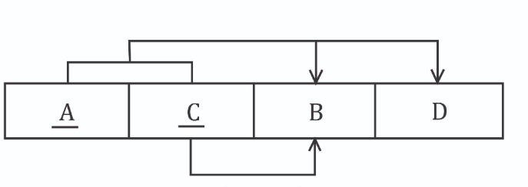
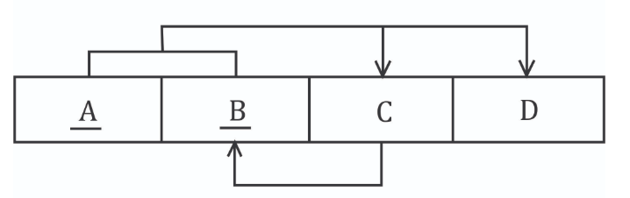
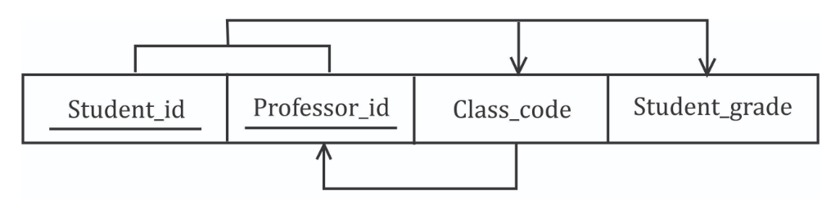
BCNF: “overlapping” candidate keys
In Boyce-Codd situation, the table has two possible combinations of candidate keys for creating the PK.
This leads to the problem of having a non-key attribute determining a key attribute.
Compare this to 2NF where the problem was a key attribute partially determining a non-key attribute.

Slide 22
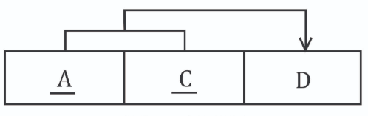
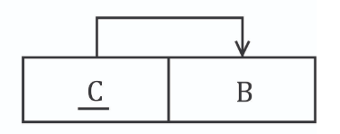
We solve it by…you guessed it…breaking out another table!

Slide 23

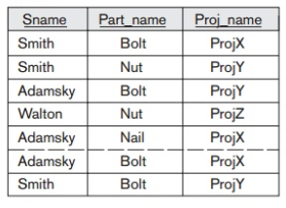
4th Normal Form
Multi-valued dependency problem:
A (pk) determines B (non-key)
A (pk) determines C (non-key)
But
B and C are independent.
Stated another way, A determines B, and A determines C, but A does not determine B and C together.

Slide 24
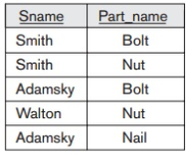
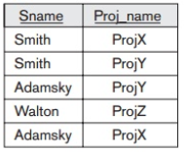
4th Normal Form
Multi-valued dependency problem:
A (pk) determines B (non-key)
A (pk) determines C (non-key)
But
B and C are independent.
Stated another way, A determines B, and A determines C, but A does not determine B and C together.
Break them into separate tables; same as 2nd and 3rd NF problems.

Slide 25
5th Normal Form
Join Dependency
“Lossless” decomposition test:
The process of decomposing the columns of a table into smaller and smaller tables, until it cannot be decomposed any further without losing the relations between the columns. Hence the term “join dependency.”
This NF is used to speed up query processes similar to a partitioning or an indexing strategy.

Slide 26
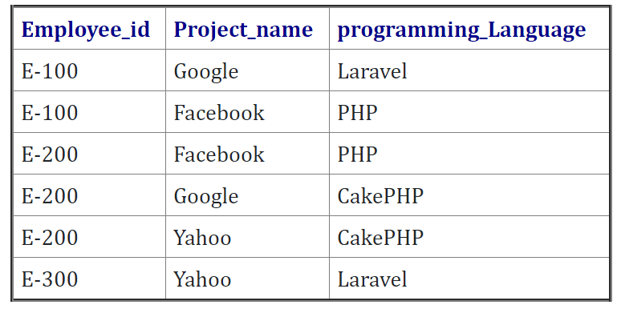
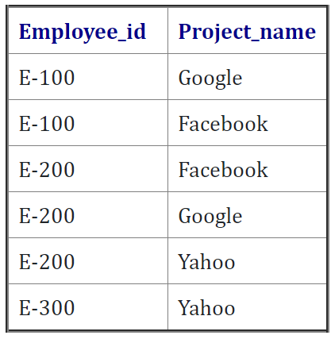
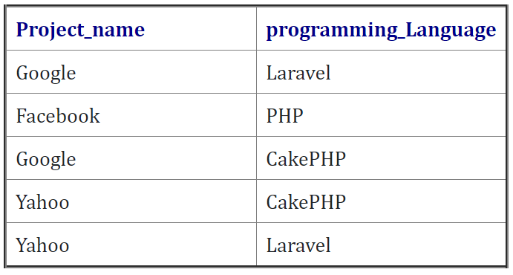
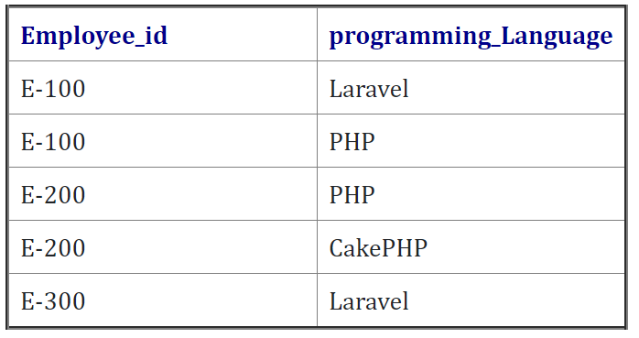
5th NF: Lossless Join Decomposition
Think of this as “enhanced” vertical partitioning
Original Table
Decomposed into
--Lossless Join Test
Select employeeID, projectname, programminglanguage
From table 1 Join table 2
On projectname = projectname
Join table 3
On programminglanguage = programminglanguage

Slide 27
6th Normal Form
DKNF: Domain Key Normal Form
Break tables into smaller tables with the fewest possible number of columns – only 2 columns if possible.
If 5th NF was “enhanced” vertical partitioning, then think of 6th NF as, “extreme” vertical partitioning.

Slide 28
5th versus 6th
Customer(CustID, FN, LN, Street, City, State, Zip)
Customer(CustID, FN, LN, Street, Zip)
City(Zip, City)
State(Zip, State)
Customer(CustID, FN, LN, Street, City, State, Zip)
FirstName(CustID, FN)
LastName(CustID, LN)
Street(CustID, Street)
City(CustID, City)
Zip(City, Zip)
State(State, Zip)

Slide 29
Practical Applications of 5th and 6th NFs
These NF principles are the foundations for designing data warehouse schemas.
Look up tables (key look up):
Static values that will not change can be placed in 5th or 6th NF tables to speed up queries.
Remember check constraints from ISM4212 →State like [A-Z][A-Z].
https://www.sqlmvp.org/lookup-table-in-sql-server/
https://www.itprotoday.com/sql-server/designing-performance-lookup-tables
https://www.sqlservercentral.com/articles/lookup-table-design

Slide 30
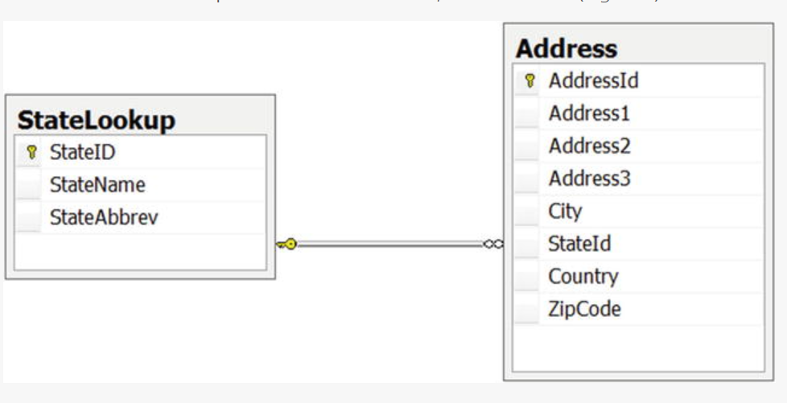
Lookup Table Example
Compare using a look up table as a constraint versus using a check on a column
PK
FK

